Slide 1
Coin Game

Slide 2
Core Rules

Slide 3
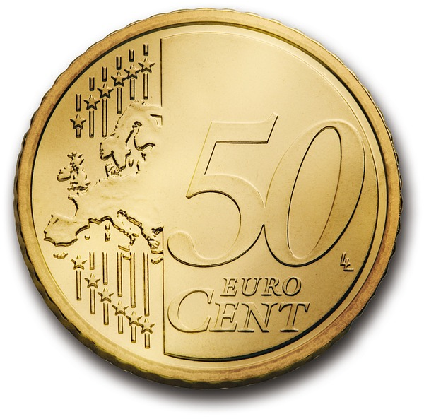
Rules
2 players and 5 coins
The players take turns either taking one or taking two coins
The player taking the last coin loses

Slide 4
Example
The game starts with five coins
Alice
Bob

Slide 5

Example
The game starts with five coins
Alice takes two coins
Alice
Bob

Slide 6

Example
The game starts with five coins
Alice takes two coins
Bob takes two coins
Alice
Bob

Slide 7
Example
The game starts with five coins
Alice takes two coins
Bob takes two coins
Alice takes one coin
Alice
Bob

Slide 8
Example
The game starts with five coins
Alice takes two coins
Bob takes two coins
Alice takes one coin
Alice loses, she got the last coin!
Alice
Bob

Slide 9
Meet the AI

Slide 10
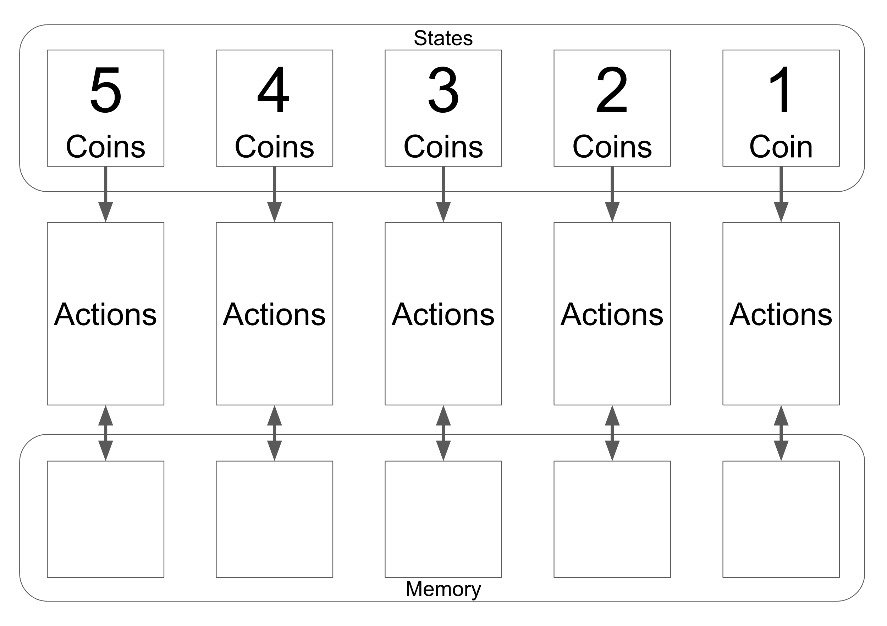
AI Board
current state (coins on the table)
1
1
1
1
1
2
2
2
2
2

Slide 11
AI Board
current state (coins on the table)
1
1
1
1
1
available actions (take 1 or 2 coins)
2
2
2
2
2

Slide 12
AI Board
current state (coins on the table)
1
1
1
1
1
available actions (take 1 or 2 coins)
2
2
2
2
2
Memory
(remember last action)

Slide 13
Rewards
Remove last action, whenever the AI…
has lost
has chosen an invalid action
can’t find an action
Change nothing, on all other occurrences

Slide 14
Game 1
The game starts with five coins, Alice plays like normal and Bob plays as the AI
1
1
1
1
1
2
2
2
2
2

Slide 15
Game 1
The game starts with five coins, Alice plays like normal and Bob plays as the AI
Alice takes one coin
1
1
1
1
1
2
2
2
2
2

Slide 16
Game 1
There are four coins left, therefore Bob takes a random action stone from state 4 and puts it into memory
1
1
1
1
1
2
2
2
2
2

Slide 17
Game 1
There are four coins left, therefore Bob takes a random action stone from state 4 and puts it into memory
Bob then performs the action and takes two coins
1
1
1
1
1
2
2
2
2
2

Slide 18
Game 1
Alice takes one coin
1
1
1
1
1
2
2
2
2
2

Slide 19
Game 1
Alice takes one coin
There is one coin left, therefore Bob takes a random action stone from state 1 and puts it into memory
1
1
1
1
2
2
2
2
2
1

Slide 20
Game 1
Alice takes one coin
There is one coin left, therefore Bob takes a random action stone from state 1 and puts it into memory
Bob also returns the stone which was previously in memory back to its actions field
1
1
1
1
2
2
2
2
2
1

Slide 21
Game 1
Bob then performs the action and takes one coin
1
1
1
1
2
2
2
2
2
1

Slide 22
Game 1
Bob then performs the action and takes one coin
Bob has lost, therefore he removes the stone in memory from the game
1
1
1
1
2
2
2
2
2

Slide 23
Game 1
Bob then performs the action and takes one coin
Bob has lost, therefore he removes the stone in memory from the game
Removed stones will not return for the following games!
1
1
1
1
2
2
2
2
2

Slide 24
Game 2
The game starts again with five coins, this time Bob begins
1
1
1
1
2
2
2
2
2

Slide 25
Game 2
The game starts again with five coins, this time Bob begins
There are five coins left, therefore Bob takes a random action stone from state 5 and puts it into memory
1
1
1
2
2
2
2
2
1

Slide 26
Game 2
The game starts again with five coins, this time Bob begins
There are five coins left, therefore Bob takes a random action stone from state 5 and puts it into memory
Bob then performs the action and takes one coin
1
1
1
2
2
2
2
2
1

Slide 27
Game 2
Alice takes one coin
1
1
1
2
2
2
2
2
1

Slide 28
Game 2
Alice takes one coin
There are three coins left, therefore Bob takes a random action stone from state 3 and puts it into memory
1
1
1
2
2
2
2
1
2

Slide 29
Game 2
Alice takes one coin
There are three coins left, therefore Bob takes a random action stone from state 3 and puts it into memory
Bob also returns the stone which was previously in memory back to its actions field
1
1
1
1
2
2
2
2
2

Slide 30
Game 2
Bob then performs the action and takes two coins
1
1
1
1
2
2
2
2
2

Slide 31
Game 2
Bob then performs the action and takes two coins
Alice takes one coin
1
1
1
1
2
2
2
2
2

Slide 32
Game 2
Bob then performs the action and takes two coins
Alice takes one coin
Bob has won, therefore he returns the stone in memory back to its original location
1
1
1
1
2
2
2
2
2

Slide 33
Game 3…
Continue with more games, until your AI plays perfectly!

Slide 34
Special Rules
If an action is not possible (e.g. take two when there is only one stone), remove the action stone and take another one

Slide 35
Special Rules
If an action is not possible (e.g. take two when there is only one stone), remove the action stone and take another one
If there are no action stones for the state, remove the action stone in memory from the game and continue with a random action (take one or two coins)

